Slide 1
QUICKBITE CRISIS IMPACT REPORT
Presented by,
Aleeja Ambili

Slide 2
Problem Statement
QuickBite Express is a Bengaluru-based food-tech startup (founded in 2020) that connects customers with nearby restaurants and cloud kitchens. In June 2025, QuickBite faced a major crisis. A viral social media incident involving food safety violations at partner restaurants, combined with a week-long delivery outage during the monsoon season, triggered massive customer backlash. Competitors capitalized with aggressive campaigns, worsening the situation

Slide 3
The challenges were severe:
• A large portion of active users disengaged within a short period.
• Daily orders saw a sharp decline compared to earlier months.
• Customer satisfaction scores fell sharply, signaling trust issues.
• Many partner restaurants shifted to competing platforms.
• Customer acquisition costs rose significantly.

Slide 4
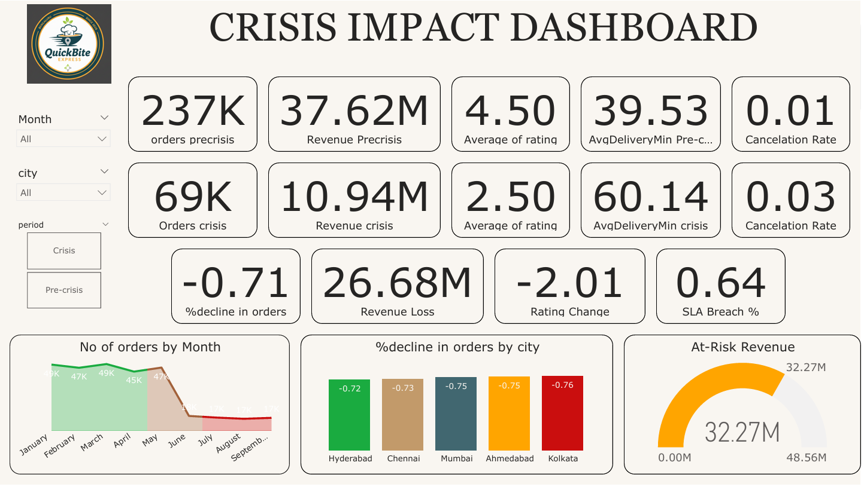

Slide 5
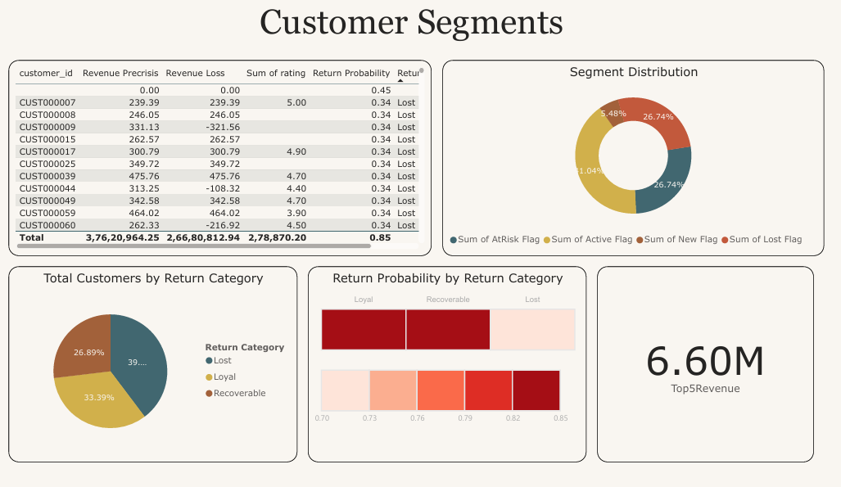

Slide 6
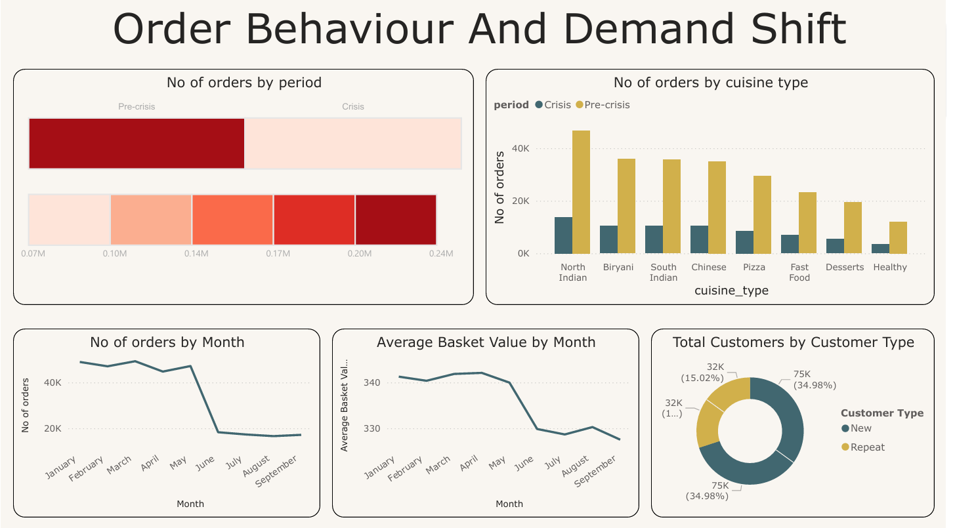

Slide 7
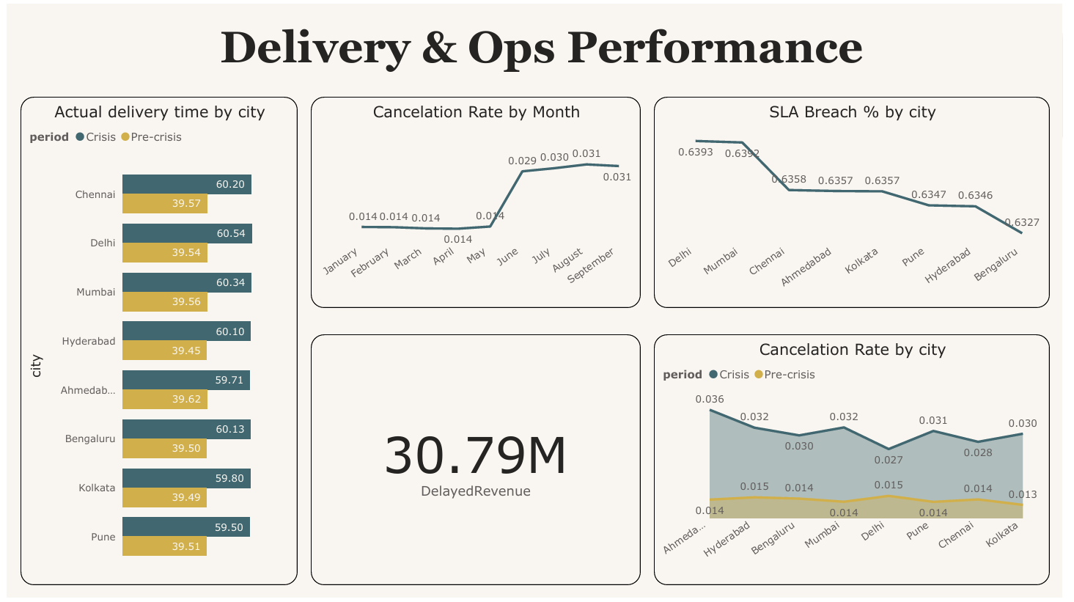

Slide 8
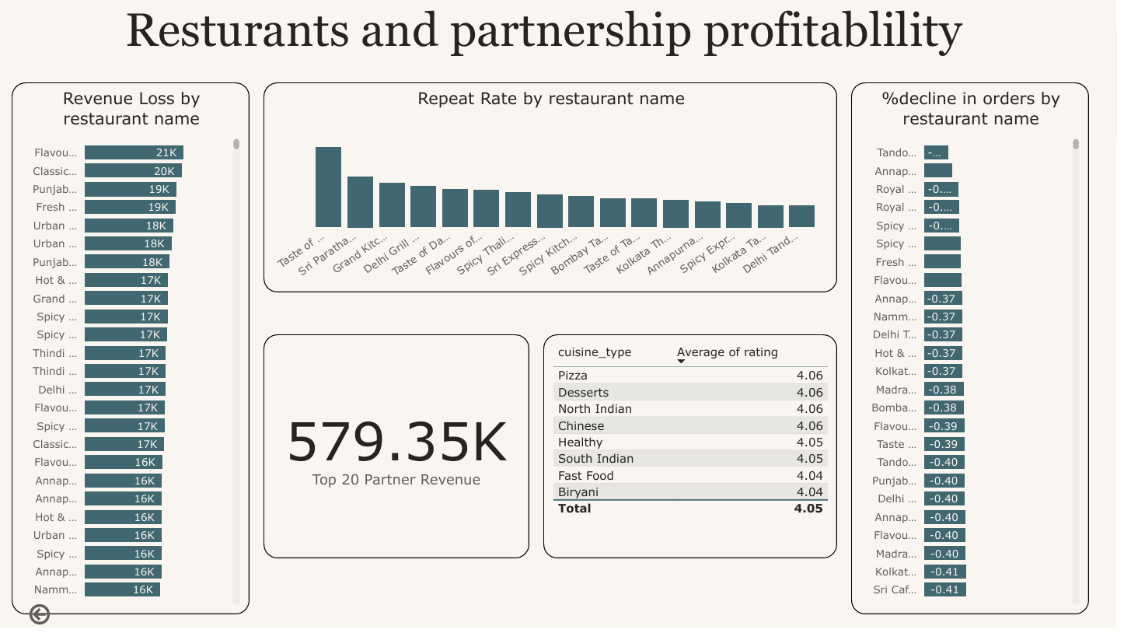

Slide 9
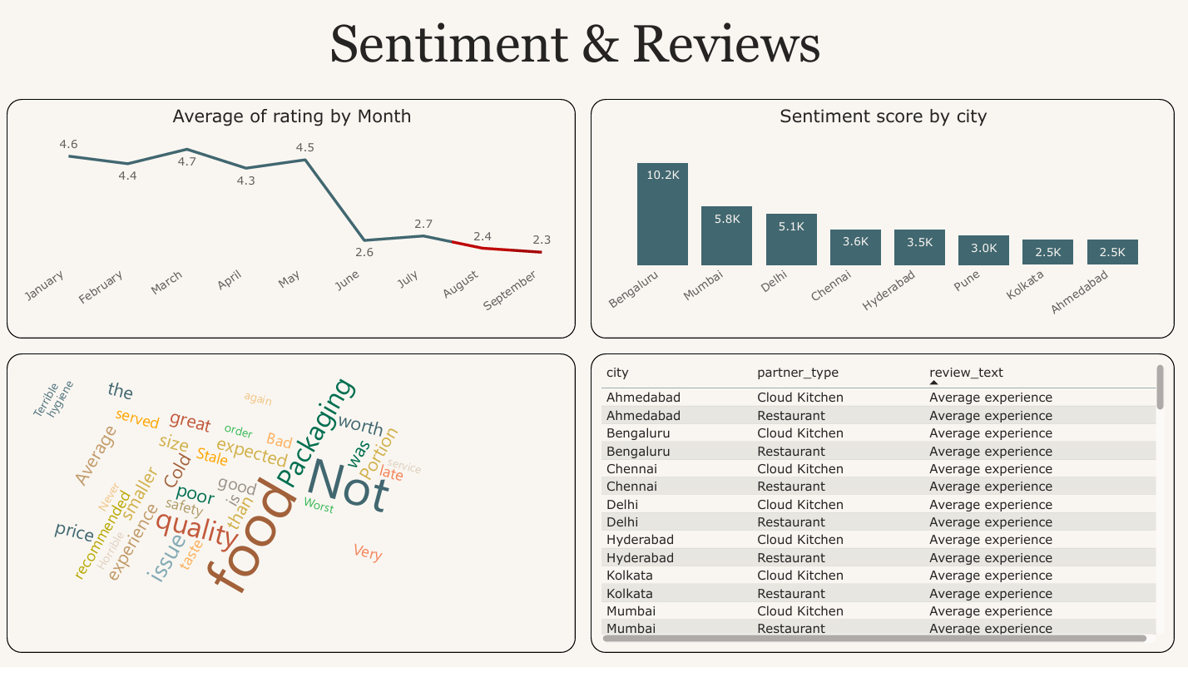

Slide 10
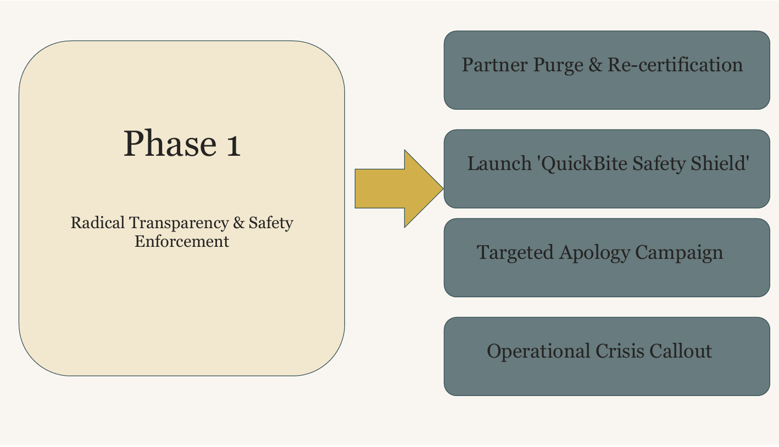

Slide 11
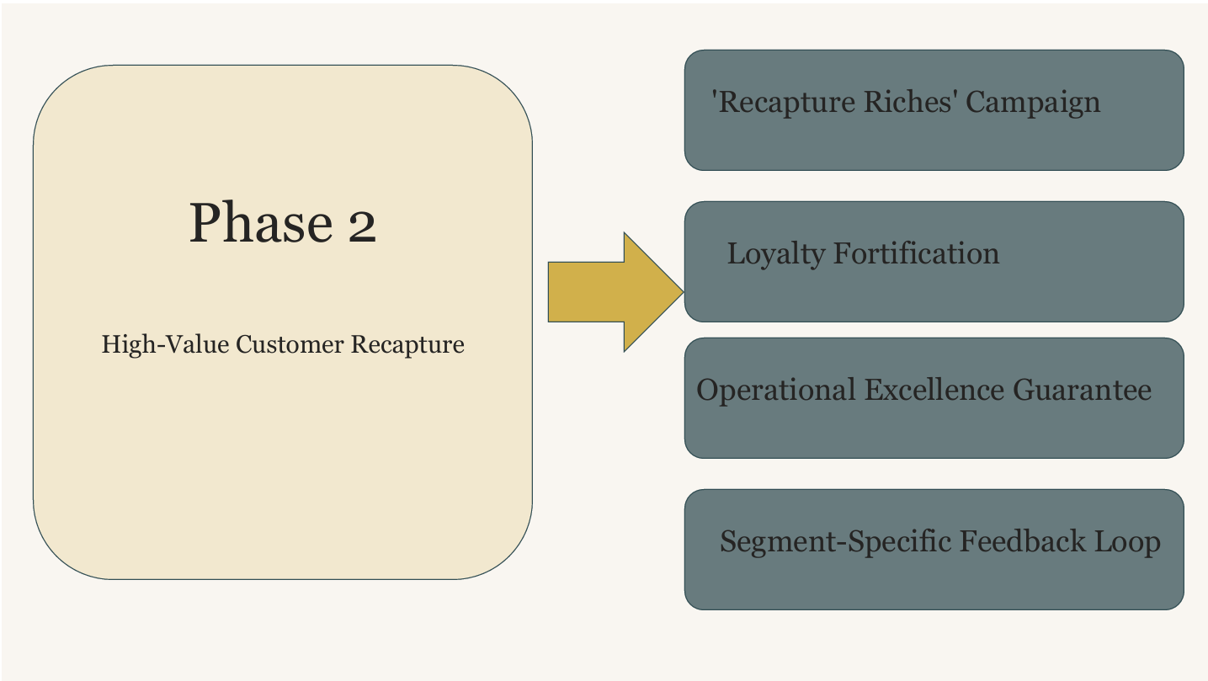

Slide 12
